Slide 1
Introduction to Survival Analysis for Developing CPMs
Dr Glen Martin
glen.martin@manchester.ac.uk

Slide 2
Outline
This session aims to introduce you to some of the key statistical concepts underpinning survival analysis for the development of a clinical prediction model for time-to-event outcomes.
Given the time constraints, we will not be able to cover all concepts in large detail. I will refer you to other sources, where relevant

Slide 3
Introduction to Survival Analysis
Generally, survival analysis is a collection of statistical procedures for data analysis for which the outcome variable of interest is time until an event occurs
Time: we mean years, months, weeks, or days from the beginning of some index date (e.g. start of study, birth, etc.) until an event occurs
Event: we mean death, disease incidence, relapse from remission, recovery, etc.
Notes:
We begin by explaining what survival analysis is, and describing the kind of problems we are interested in solving using survival analysis methods

Slide 4
Examples
Survival time after mastectomy of women with breast cancer. The question of interest is whether metastasis is associated with worse survival.
Survival time is a common outcome following a clinical trial of a treatment for very sick patients (e.g. patients with end-stage cancers). We are interested in whether the novel treatment improves survival.
Time to occurrence of a condition. For example, CPMs such as QRISK are based on time until an adverse cardiovascular event.
Time to failure of a medical device. For example, a transplant or a pacemaker.

Slide 5

Why do we need specific methods for such data?
X
There are three main things that can happen in monitoring time-to-event outcomes
?
X
Study start
Study end
Time

Slide 6
So for each individual we get a ‘pair’ of outcomes
ID | Event Time | Event Indicator
1 | 10 | 0
2 | 6 | 0
3 | 8 | 1
The time at which we last observed something about each patient, be that the event, loss-to-follow-up or study end
1 means the event time corresponds to observing the event of interest in that patient (e.g. death)

Slide 7
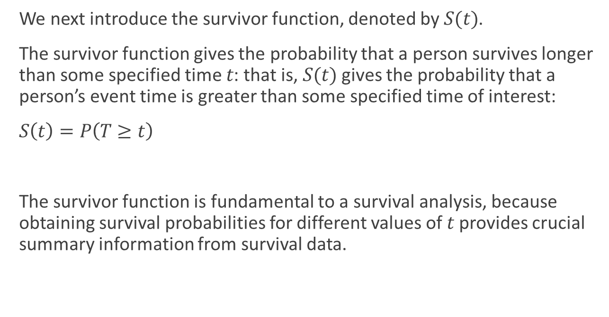
Survival Function
We next introduce the survivor function, denoted by $S(t)$.
The survivor function gives the probability that a person survives longer than some specified time $t$: that is, $S(t)$ gives the probability that a person’s event time is greater than some specified time of interest:
$S\left(t\right)=P\left(T≥t\right)$
The survivor function is fundamental to a survival analysis, because obtaining survival probabilities for different values of $t$ provides crucial summary information from survival data.

Slide 8

Kaplan-Meier Estimate
One can estimate $S(t)$ using a formula called the Kaplan-Meier estimate (that we don’t present here), which can be illustrated in a Kaplan-Meier plot
Notes:
Talk through what this plot shows.
The dashed lines are 95% confidence intervals/regions. The vertical lines are showing where censoring events occur.
Interpretation of the plot: we see a fairly steep decline in the survival function over the first 50 days (i.e. regular deaths). This levels off after 50 days (the deaths slow down). By the end of follow-up we estimate about a third of the patients are still alive.
Survival time is commonly summarised using the median. This can be read from the Kaplan-Meier plot, as the value $t$ such that $S\left(t\right)=0.5$.

Slide 9
Stratified Kaplan-Meier Estimate
We can also calculate/plot the Kaplan-Meier estimates across different group of patients by splitting the data based on a categorical variable (e.g. Males vs. Female)
Notes:
Velocity of the curves to link with the hazard function on next slide

Slide 10
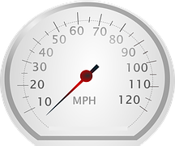


How do we model survival data to develop a CPM?
To motive this, we need to introduce another important concept called the hazard function.
The hazard function $h(t)$ gives the instantaneous potential per unit time for the event to occur, given that the individual has survived up to time t.
E.g.
Similar to a speedometer giving the instantaneous velocity at a given moment, $h(t)$ gives the instantaneous potential at time t for getting an event, like death or some disease of interest, given survival up to time t.
Notes:
for example, you are driving in your car and you see that your speedometer is registering 60 mph, what does this reading mean? It means that if in the next hour, you continue to drive this way, with the speedometer exactly on 60, you would cover 60 miles. This reading gives the potential, at the moment you have looked at your speedometer, for how many miles you will travel in the next hour. However, because you may slow down or speed up or even stop during the next hour, the 60-mph speedometer reading does not tell you the number of miles you really will cover in the next hour. The speedometer tells you only how fast you are going at a given moment; that is, the instrument gives your instantaneous potential or velocity.
The “given” part, that is, “surviving up to time t”, is analogous to recognizing in the velocity example that the speedometer reading at a point in time inherently assumes that you have already travelled some distance (i.e., survived) up to the time of the reading.

Slide 11

Cox Proportional Hazards Modelling
The most common way of modelling survival data (and therefore developing a CPM) is based on the hazard function through a technique called Cox Proportional Hazards.
The Cox proportional hazard model is based on the assumption that:
The hazard function for all patients has the same shape.
Covariates have the effect of multiplying this hazard function by a constant factor.
Baseline hazard: the hazard ‘shared’ by the whole population
$h\left(t\right)=h_{0}\left(t\right)\exp{{(β}_{1}x_{1}}+ β_{2}x_{2}+…+β_{p}x_{p}$)
Individual covariates that multiply the baseline hazard by a factor
Notes:
Add in the link with logistic regression

Slide 12
Why is the baseline hazard important?
Without them, you only get a relative risk
Absolute risks are better for communicating with the public
Cox Proportional Hazard models are popular because they make hardly any assumptions about the shape of the baseline hazard.
While this is good for association studies, it is problematic for developing CPMs (since we need absolute estimates of survival/hazard risk).

Slide 13
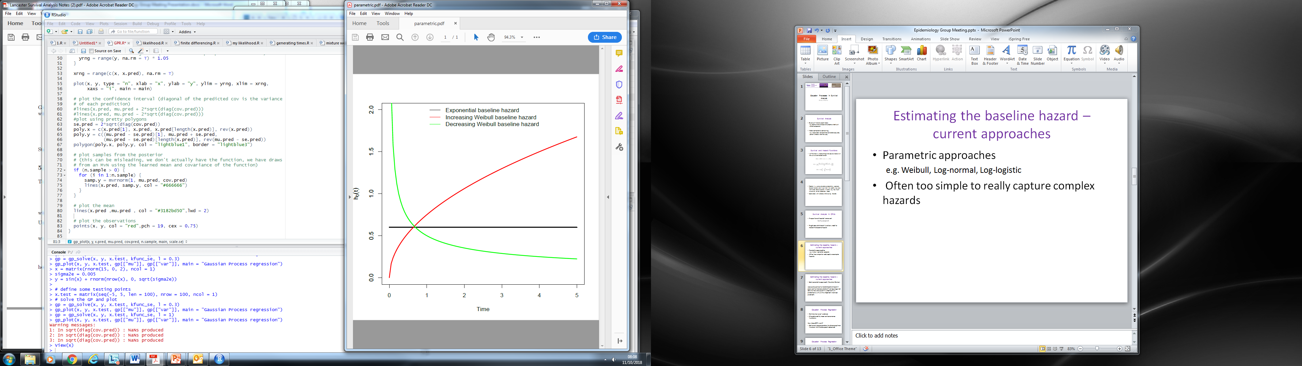
Estimating the Baseline Hazard
Parametric approaches
e.g. Weibull, Log-normal, Log-logistic
Often too simple to really capture complex hazards

Slide 14
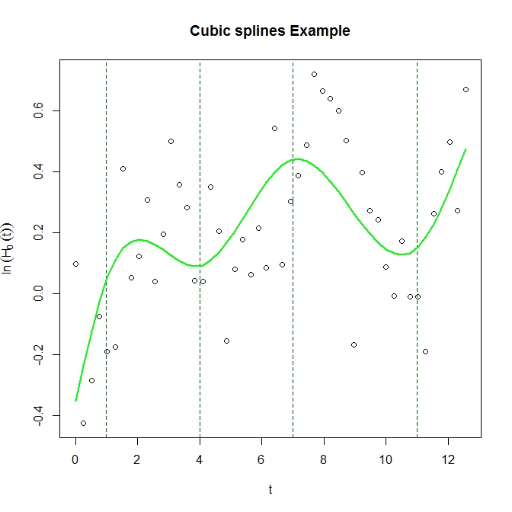
Estimating the Baseline Hazard
Semi-parametric approach (Royston-Parmar)
Uses natural cubic splines to model log cumulative baseline hazard 𝐻_0 (𝑡)
This is an advanced topic. I refer people to the literature (https://onlinelibrary.wiley.com/doi/pdf/10.1002/sim.1203).
There are R/Stata packages to fit these types of model

Slide 15
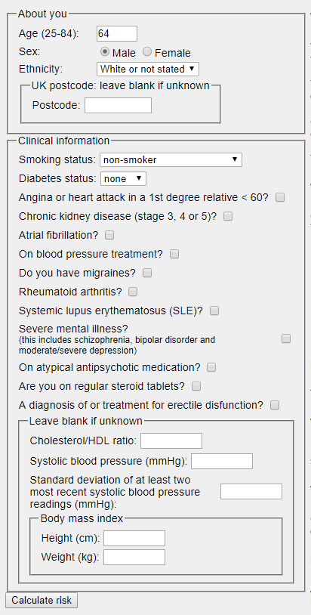
Case-Study: QRISK 3
QRISK-3 is a time to event model (Cox model) that predicts the risk of developing cardiovascular disease within 10-years.
The model uses point estimates at ten-years (Breslow estimates) of the cox baseline hazard in order to report absolute risk
Used in UK medical NICE guidelines (anyone with QRISK>10% is prescribed a statin)

Slide 16
Advanced Topics in Survival Analysis
This lecture has barely touched the surface in terms of survival analysis.
Some advanced topics in the area include:
Time-updated covariates (We have only considered here covariates that are available at baseline. In reality, information about patients may change (or be updated) as the study progresses.)
Time-varying coefficients (effect of a particular covariate might change over time – i.e. non-proportional hazards)
Recurrent events (to explore events that are non-terminal)
Competing risks (patients may be at risk of multiple different outcomes, that compete against each other, such that only one outcome may occur. E.g. ‘death due to cancer’, but also at risk of ‘death due to cardiovascular disease’ and ‘death due to other causes’, etc, - can be only one (primary) cause of death. )

Slide 17
Take Home Messages
Survival analysis in challenging due to the possibility of censoring
We can use time-to-event models to explore the relationships between variables of interest and a time-to-event outcome
To develop a time-to-event CPM, one needs an estimate of the baseline hazard function, which means moving away from the classic Cox Proportional Hazards model

Slide 18



Thank you
Glen Martin
Centre for Health Informatics
The University of Manchester, UK
glen.martin@manchester.ac.uk
@glen_martin1

